Slide 1

Marketing Attribution
Analyze Data with SQL
Fabien Clauss
2019-10-23

Slide 2
Example Table of Contents
Get familiar with CoolTShirts
  Sources and Campaigns
  CoolTShirts Website
What is the user journey
  First Touches
  Last Touches
  Purchases
  Purchase as Last Touch
  Re-investments

Slide 3
1. Get familiar with CoolTShirts

Slide 4
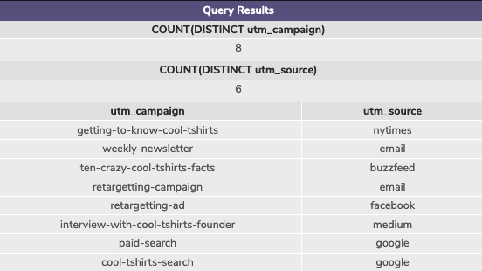
1.1 Sources and Campaigns
How many campaigns and sources does CoolTShirts use? Which source is used for each campaign?
Use three queries:
one for the number of distinct campaigns,
one for the number of distinct sources,
one to find how they are related.
SELECT COUNT(DISTINCT utm_campaign)
FROM page_visits;
SELECT COUNT(DISTINCT utm_source)
FROM page_visits;
SELECT DISTINCT utm_campaign, utm_source
FROM page_visits;
From the last query, we see:
The getting-to-know-cool-tshirt campaign corresponds to an article or add in the NYTimes
The weekly-newsletter campaign is an email
Another article is buzzfeed
The retargeting-campaign is done on Facebook
The interview with the founder is on medium
The searches are coming from google

Slide 5
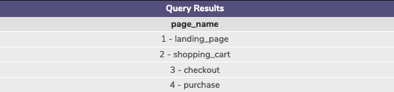
1.2 CoolTShirts Website
2. What pages are on the CoolTShirts website?
Find the distinct values of the page_name column.
SELECT DISTINCT page_name
FROM page_visits;
There are 4 pages on the website as shown by the query results below

Slide 6
2. What is the user journey

Slide 7
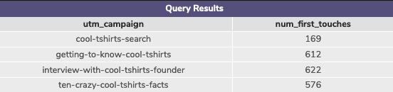
2.1 First Touches
3. How many first touches is each campaign responsible for?
You’ll need to use the first-touch query from the lesson (also provided in the hint below). Group by campaign and count the number of first touches for each.
WITH first_touch AS (
SELECT user_id,
MIN(timestamp) as first_touch_at
FROM page_visits
GROUP BY user_id)
SELECT pv.utm_campaign,
COUNT(ft.first_touch_at) as num_first_touches
FROM first_touch ft
JOIN page_visits pv
ON ft.user_id = pv.user_id
AND ft.first_touch_at = pv.timestamp
GROUP BY pv.utm_campaign;
The interview produced the most first touches followed closely by the articles in the NYTimes first and buzzfeed.
The google searches produced the least first touches, which makes sense, since people who know about a company tend to go directly to the website instead of searching.

Slide 8
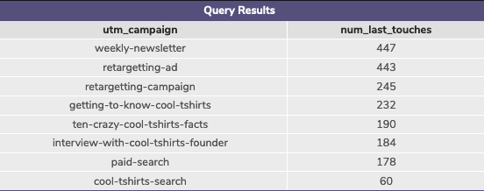
2.2 Last Touches
4. How many last touches is each campaign responsible for?
Starting with the last-touch query from the lesson, group by campaign and count the number of last touches for each.
WITH last_touch AS (
SELECT user_id,
MAX(timestamp) as last_touch_at
FROM page_visits
GROUP BY user_id)
SELECT pv.utm_campaign,
COUNT(lt.last_touch_at) as num_last_touches
FROM last_touch as lt
JOIN page_visits as pv
ON lt.user_id = pv.user_id
AND lt.last_touch_at = pv.timestamp
GROUP BY pv.utm_campaign
ORDER BY 2 DESC;
The list produced by the query is ordered in descending order. This way we see immediately that the newsletter and retargeting ad are producing the most last touches. The retargeting campaign is fairly successful as well as the articles, interview and paid search. The cool-tshirt search is least efficient when it come to last touches.
The google searches produced the least first touches, which makes sense, since people who know about a company tend to go directly to the website instead of searching.

Slide 9

2.3 Purchases
5. How many visitors make a purchase?
Count the distinct users who visited the page named 4 - purchase.
SELECT COUNT(DISTINCT user_id) AS num_purchase
FROM page_visits
WHERE page_name = '4 - purchase';
361 user visited the page 4, which means they made a purchase.

Slide 10
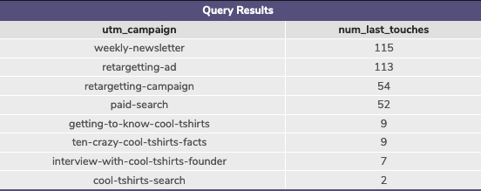
2.4 Purchase as Last Touch
6. How many last touches on the purchase page is each campaign responsible for?
This query will look similar to your last-touch query, but with an additional WHERE clause.
WWITH last_touch AS (
SELECT user_id,
MAX(timestamp) as last_touch_at
FROM page_visits
WHERE page_name = '4 - purchase'
GROUP BY user_id)
SELECT pv.utm_campaign,
COUNT(lt.last_touch_at) as num_last_touches
FROM last_touch as lt
JOIN page_visits as pv
ON lt.user_id = pv.user_id
AND lt.last_touch_at = pv.timestamp
GROUP BY 1
ORDER BY 2 DESC;
Over 60% of the purchases can be attributed to the newsletter and retargeting ad alone. Another almost 30% is attributed to the retargeting campaign and paid search.
The articles, interview and cool-tshirt search do not seem to be much involved in the purchases directly.

Slide 11
2.5 Re-investments
7. CoolTShirts can re-invest in 5 campaigns. Given your findings in the project, which should they pick and why?
There a two points to consider here:
First the users have to get to the website:
Here the articles and interview where by far the most efficient
Secondly the user visit has to turn into a purchase:
Here the newsletter and retargeting ad where overwhelmingly the best
My 5 picks would therefore be:
Getting-to-know-cool-tshirts
Ten-crazy-cool-tshirts-facts
Interview-with-cool-tshirts-founder
Weekly-newsletter
retargeting-ad

